Slide 2
Requirement simply means a thing that is needed or wanted. Requirement engineering is process of defining requirement, establishing, documenting it in a proper manner, and to keep quality of requirements of a customer from a system, and the limitations under which it operates and is developed. It is first activity of software engineering. Requirements are something that is needed to satisfy whether by designing, product, or process of a software system. Requirements can be classified as :

Slide 3
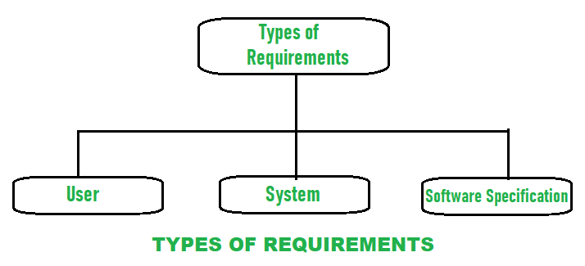

Slide 4
User requirements :
User requirement simply means needs of users that should be fulfilled by software system. It is documented in a User Requirement Document (URD).
Overall statements are generally written in natural language plus a description of the services system provides and its operational constraints.
User requirement is good if it is clear and short, results in increasing overall quality, increases productivity, is traceable, etc.

Slide 5
System Requirements
System requirement simply means needs of system to run smoothly and efficiently.
It is a structured document that gives a detailed description of system functions, services, and operational constraints. It requires many hardware and software resources.
If these hardware and software resources are not or less available, then it may result in system failure or causes problems during performance.
Between client and contractor, it is written as a contract to define all requirements that are needed to be implemented to increases productivity.

Slide 6
Software specification :
It is a detailed description of software system requirements with the help of which designing and implementation can be done to develop software.
For software developers, software specification is usually written that makes it easier for the developer to understand overall requirement of software.

Slide 7
Functional vs Non Functional Requirements
Requirements analysis is very critical process that enables the success of a system or software project to be assessed.
Requirements are generally split into two types: Functional and Non-functional requirements.

Slide 8
Functional Requirements:
These are the requirements that the end user specifically demands as basic facilities that the system should offer.
All these functionalities need to be necessarily incorporated into the system as a part of the contract.
These are represented or stated in the form of input to be given to the system, the operation performed and the output expected.
They are basically the requirements stated by the user which one can see directly in the final product, unlike the non-functional requirements.

Slide 9
Non-functional requirements:
These are basically the quality constraints that the system must satisfy according to the project contract.
The priority or extent to which these factors are implemented varies from one project to other.
They are also called non-behavioral requirements.

Slide 10
They basically deal with issues like:
Portability
Security
Maintainability
Reliability
Scalability
Performance
Reusability
Flexibility

Slide 11
These can be classified as :
Performance constraints – Reliability, security, response time, etc.
Operating constraints – These include physical constraints (size, weight), personnel availability, skill level considerations, system accessibility for maintenance, etc.
Interface constraints – These describe how the system is to interface with its environment, users, and other systems. For example, user interfaces and their qualities (e.g., user-friendliness).
Economic constraints – Immediate and/or long-term costs.
Lifecycle requirements – Quality of the design: These measured in terms such as maintainability, enhance ability, portability.

Slide 12
Advantages of Non-Functional Requirement :
They ensure the software system follows legal and adherence rules.
They specify the quality attribute of the software.
They ensure the reliability, availability, performance, and scalability of the software system
They help in constructing the security policy of the software system.
They ensure good user experience, ease of operating the software, and minimize the cost factor.

Slide 13
Disadvantages of Non-functional requirement :
The nonfunctional requirement may affect the various high-level software subsystem.
They generally increase the cost as they require special consideration during the software architecture/high-level design phase.
It is difficult to change or alter non-functional requirements once you pass them to the architecture phase.

Slide 14
Following are the differences between Functional and Non Functional Requirements
Functional Requirements | Non Functional Requirements
A functional requirement defines a system or its component. | A non-functional requirement defines the quality attribute of a software system.
It specifies “What should the software system do?” | It places constraints on “How should the software system fulfill the functional requirements?”
Functional requirement is specified by User. | Non-functional requirement is specified by technical peoples e.g. Architect, Technical leaders and software developers.
It is mandatory. | It is not mandatory.
It is captured in use case. | It is captured as a quality attribute.
Defined at a component level. | Applied to a system as a whole.
Helps you verify the functionality of the software. | Helps you to verify the performance of the software.
Functional Testing like System, Integration, End to End, API testing, etc are done. | Non-Functional Testing like Performance, Stress, Usability, Security testing, etc are done.
Usually easy to define. | Usually more difficult to define.
Example1) Authentication of user whenever he/she logs into the system. 2) System shutdown in case of a cyber attack. 3) A Verification email is sent to user whenever he/she registers for the first time on some software system. | Example1) Emails should be sent with a latency of no greater than 12 hours from such an activity. 2) The processing of each request should be done within 10 seconds 3) The site should load in 3 seconds when the number of simultaneous users are > 10000

Slide 15
Four Phases of Requirement Engineering

Slide 16
Requirement Engineering is the process of defining, documenting and maintaining the requirements. It is a process of gathering and defining service provided by the system. Requirements Engineering Process consists of the following main activities:
Requirements elicitation
Requirements specification
Requirements verification and validation
Requirements management

Slide 17
Requirements Elicitation:
It is related to the various ways used to gain knowledge about the project domain and requirements. The various sources of domain knowledge include customers, business manuals, the existing software of same type, standards and other stakeholders of the project. The techniques used for requirements elicitation include interviews, brainstorming, task analysis, Delphi technique, prototyping, etc. Some of these are discussed here. Elicitation does not produce formal models of the requirements understood. Instead, it widens the domain knowledge of the analyst and thus helps in providing input to the next stage.

Slide 18
Requirements specification:
This activity is used to produce formal software requirement models. All the requirements including the functional as well as the non-functional requirements and the constraints are specified by these models in totality. During specification, more knowledge about the problem may be required which can again trigger the elicitation process. The models used at this stage include ER diagrams, data flow diagrams(DFDs), function decomposition diagrams(FDDs), data dictionaries, etc.

Slide 19
Requirements verification and validation:
Verification: It refers to the set of tasks that ensures that the software correctly implements a specific function. Validation: It refers to a different set of tasks that ensures that the software that has been built is traceable to customer requirements. If requirements are not validated, errors in the requirement definitions would propagate to the successive stages resulting in a lot of modification and rework.

Slide 20
The main steps for this process include:
The requirements should be consistent with all the other requirements i.e no two requirements should conflict with each other.
The requirements should be complete in every sense.
The requirements should be practically achievable.
Reviews, buddy checks, making test cases, etc. are some of the methods used for this.

Slide 21
The requirements should be consistent with all the other requirements i.e no two requirements should conflict with each other.
The requirements should be complete in every sense.
The requirements should be practically achievable.
Reviews, buddy checks, making test cases, etc. are some of the methods used for this.

Slide 22
Requirements management:
Requirement management is the process of analyzing, documenting, tracking, prioritizing and agreeing on the requirement and controlling the communication to relevant stakeholders.
This stage takes care of the changing nature of requirements. It should be ensured that the SRS is as modifiable as possible so as to incorporate changes in requirements specified by the end users at later stages too.
Being able to modify the software as per requirements in a systematic and controlled manner is an extremely important part of the requirements engineering process.

